Slide 1
Obesity Prediction
Group 3
CHENYI ZHAO, JINGHAN FENG
ZIXUAN ZHANG, YAHUI QIAN
Notes:
Use the chat to introduce yourself and the courses you teach!

Slide 2


Problem Statement
Obesity (body mass index (BMI) ≥ 30 kg/m²) is a major public health problem worldwide, resulting in comorbidities and premature death. The simple definition of obesity as a disease characterized by excessive body fat does not sufficiently express the devastating health damages for individuals or reflect the large financial costs the disease imposes on societies. Obesity is responsible for elevated rates of type 2 diabetes mellitus (DM), hypertension, dyslipidaemia, steatohepatitis, polycystic ovary syndrome, depression, certain types of cancer and several other disorders.

Slide 3
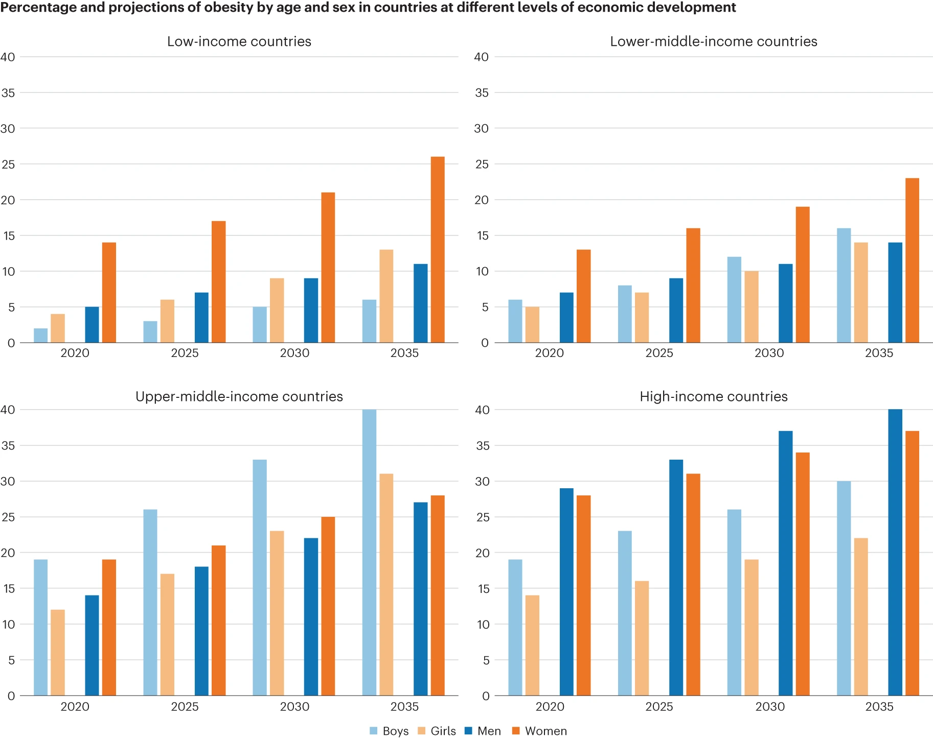
Literature Review
Obesity rates are increasing rapidly in developing countries, particularly among lower-income populations, where economic inequality exacerbates the issue (Ferreira et al., 2024). While machine learning (ML) models have been widely applied in obesity prediction, most existing models are trained on data from developed nations, limiting their applicability to low-income populations in developing regions (Lucena et al., 2024).
Additionally, public health policies play a critical role in obesity prevention, yet current research lacks a comprehensive approach that integrates ML-based predictive models with personalized public health interventions (Ferreira et al., 2024). Addressing these challenges is crucial for designing effective obesity management strategies in developing countries, where healthcare access and economic constraints further complicate intervention efforts.

Slide 4
Research Objective
1To develop an obesity prediction model tailored for low-income populations in developing countries by leveraging machine learning techniques trained on locally relevant datasets.
In this context, Latin American countries like Mexico, Brazil and Colombia serve as good proxies to understand the behaviour of obesity in developing countries, not only because of the increasing trends of obesity in these countries, but also because of their most recent attempts to adopt measures to counteract these trends. All of them are upper-middle-income economies.
2 To integrate ML-based prediction models with public health intervention strategies, aiming to enhance personalized obesity prevention efforts.
3 To evaluate the effectiveness of the proposed model and intervention framework in providing actionable insights for public health policymakers.

Slide 5

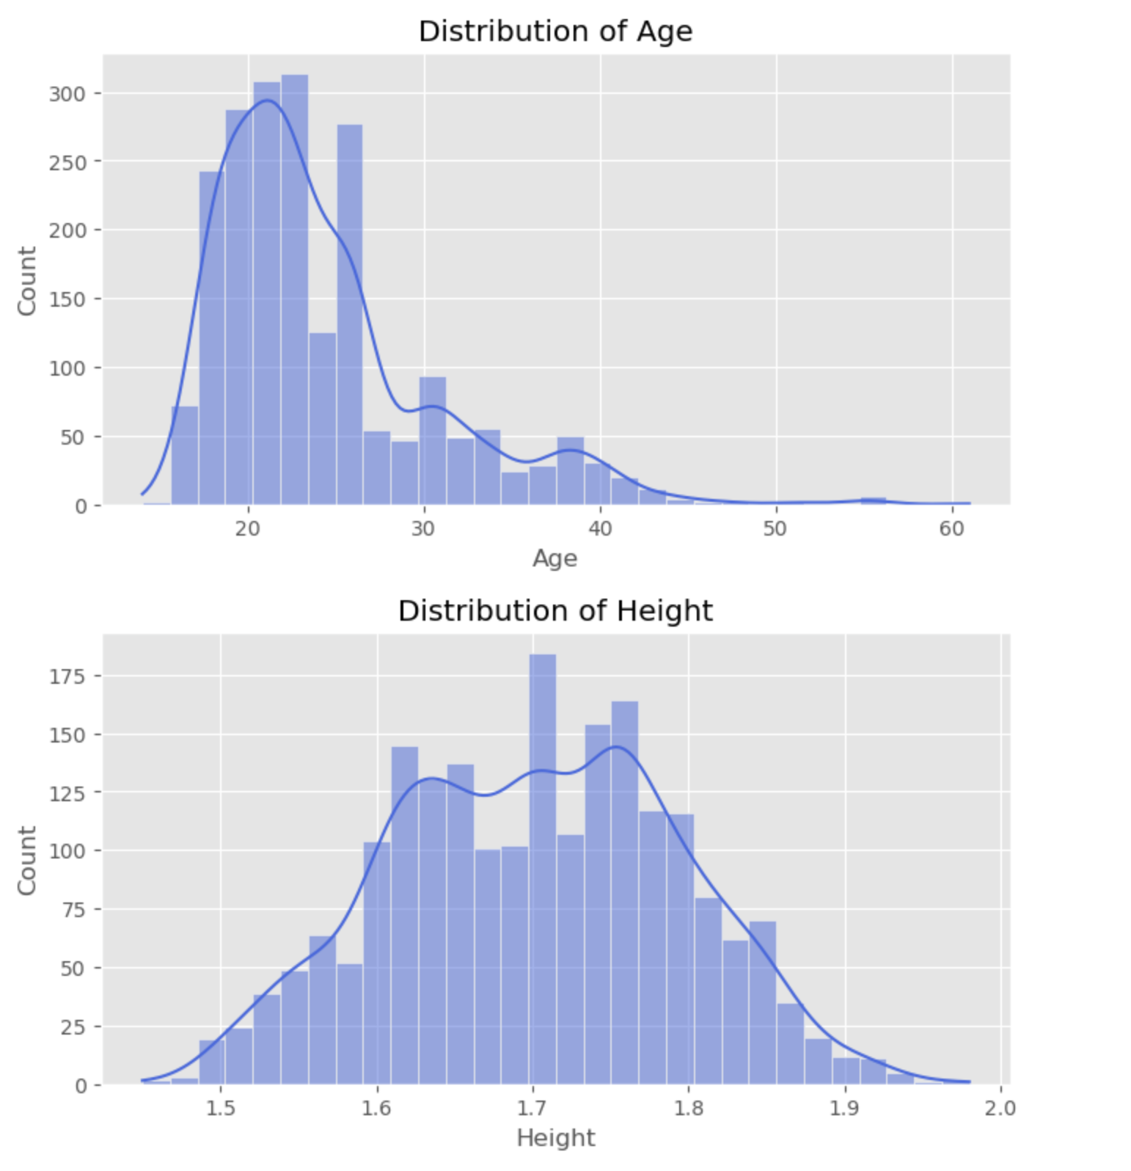
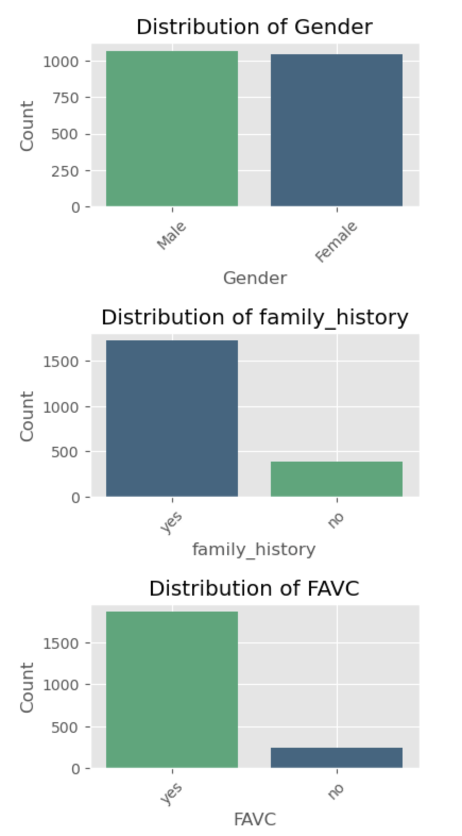
Exploratory Data Analysis
Histograms were plotted for all numerical variables to assess their distributions.
Numerical Feature
Exploratory Data Analysis
Count plots were generated for all categorical features, revealing various trends.
Categorical Feature

Slide 6
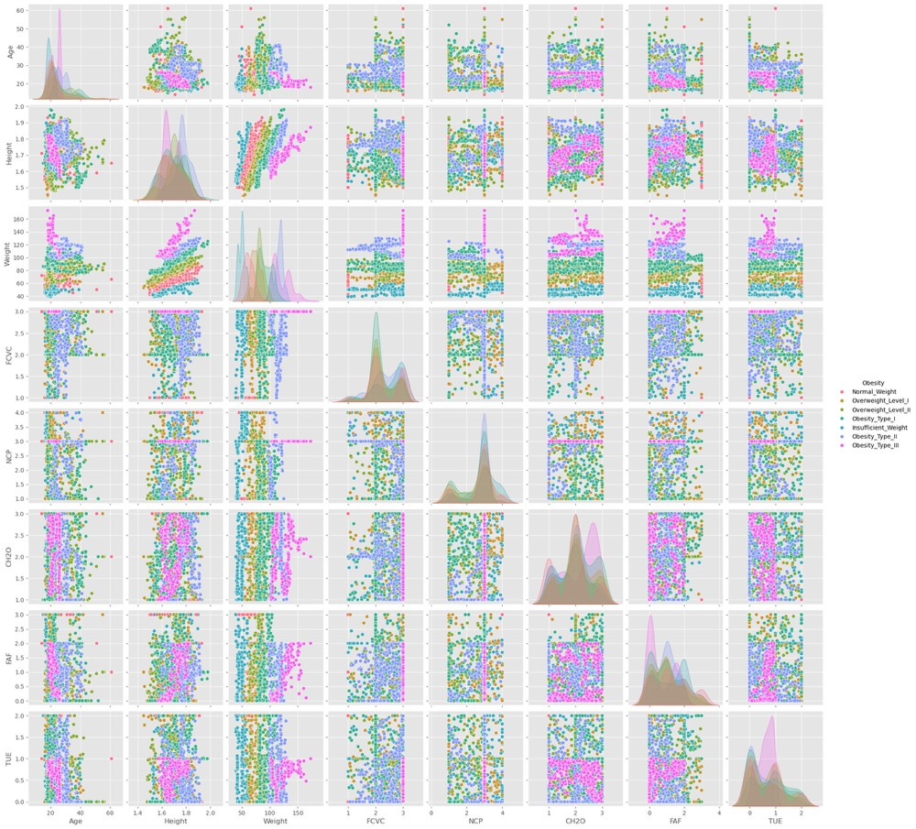
Exploratory Data Analysis
Feature Interactions and Relationships
Pairplot Analysis
A pairplot was used to visualize multi-variable relationships and feature separability.
Weight is the strongest predictor of obesity levels.
Individuals with healthier habits, such as frequent vegetable and water intake, tend to have lower obesity levels.
Long screen time and low physical activity are associated with higher obesity risks.

Slide 7
Data Preparation & Feature Engineering
Feature Selection Methods
Recursive Feature Elimination (RFE)
SelectKBest (ANOVA F-test)
LassoCV (L1 Regularization)
Encoding Categorical Variables
Missing Values Check
Take the common features selected by all three methods.
If fewer than 10, supplement with features from the combined selection.
Standardize Numerical Features
Create New Feature Obesity_Risk

Slide 8
Methodology & Modeling
Tooling:Anaconda Hardware:CPU
Model Selection
Steps for Model Training
Logistic Regression ❌❌ Low Accuracy
Baseline Model
Cross-Validation
SVM, Support Vector Machine
Random Forest, RF
Hyperparameter Tuning
Cross-Validation
Gradient Boosting
Neural Network Model：MLP, Multi-layer Perceptron
Evaluate the Optimized Model
Deep Neural Network with Multi-Layer Perceptron
More Hidden Layers

Slide 9
Model Performance
Model | Accuracy | Precision | Recall | F1-Score
SVM | 96.69% | 0.97 | 0.97 | 0.97
Gradient Boosting | 96.22% | 0.97 | 0.96 | 0.96
Random Forest | 93.85% | 0.94 | 0.94 | 0.94
MLP | 97.64% | 0.98 | 0.98 | 0.98
DNN | 93.38% | 0.93 | 0.93 | 0.93
MLP achieved the highest accuracy (0.9764), making it the best-performing model in this evaluation. 👍👍👍
SVM and Gradient Boosting also performed exceptionally well, with 0.9669 and 0.9622 accuracy, respectively.

Slide 10
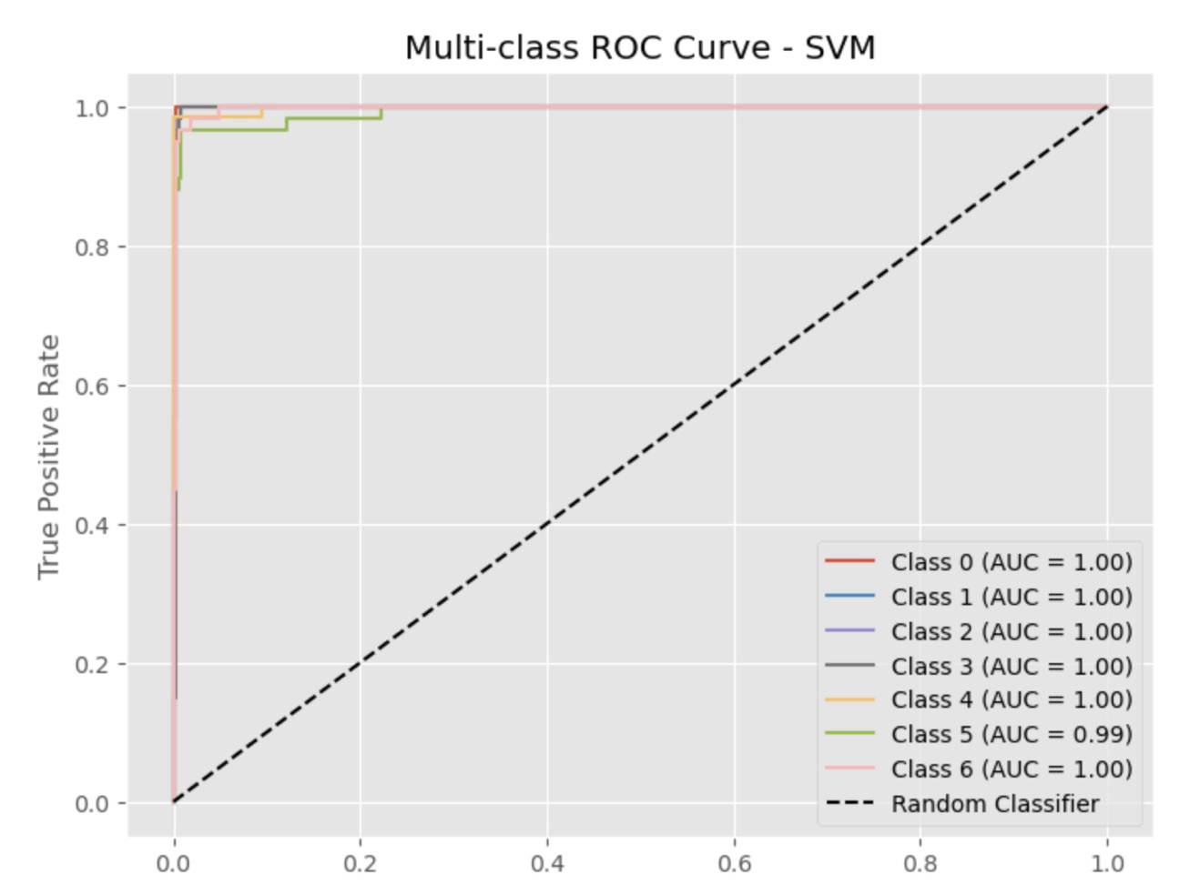
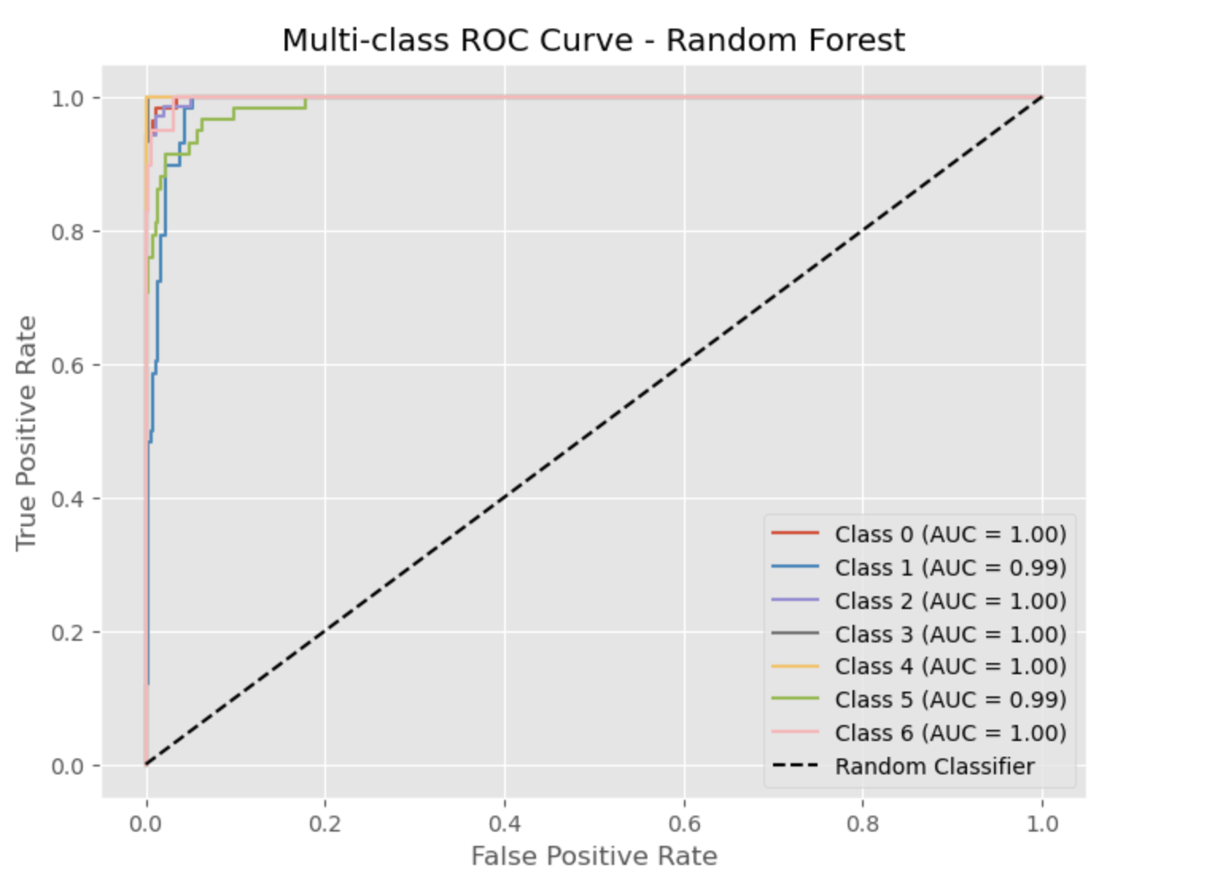
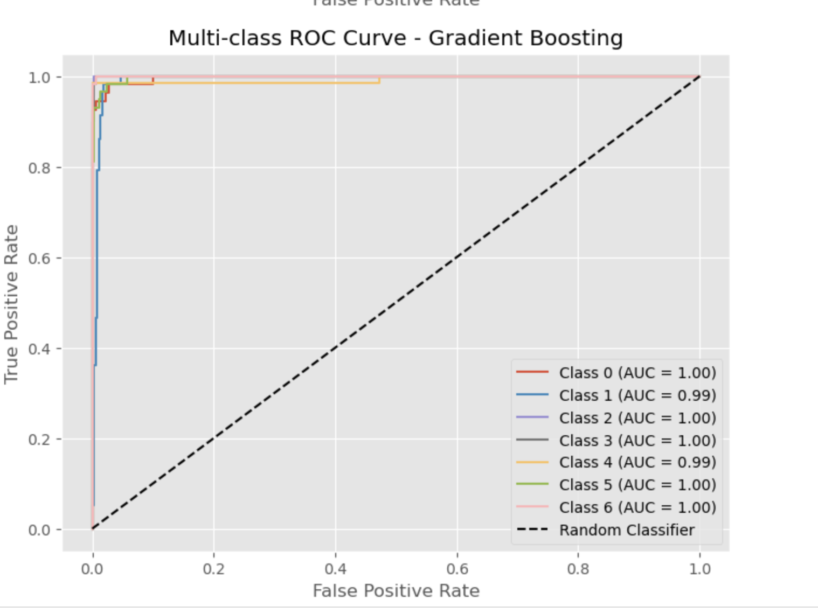
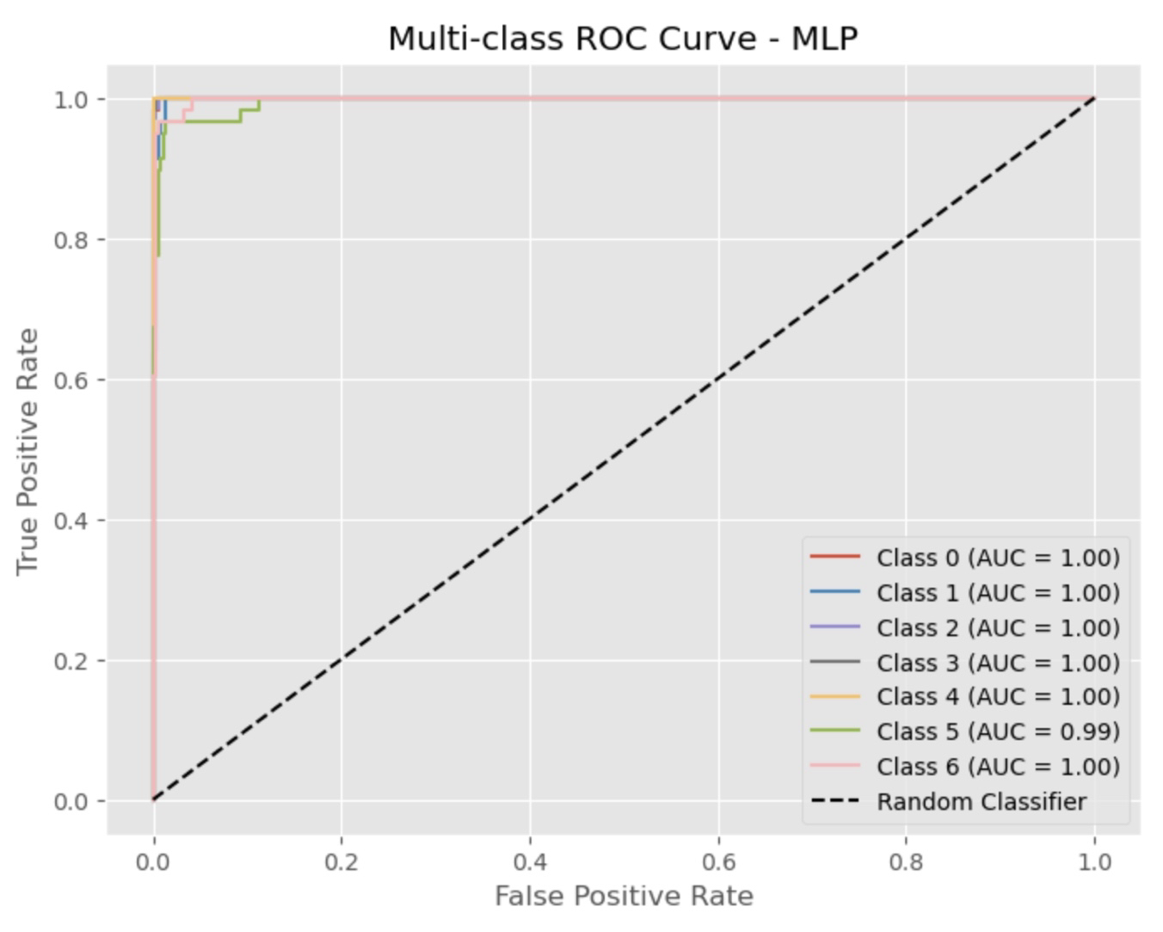
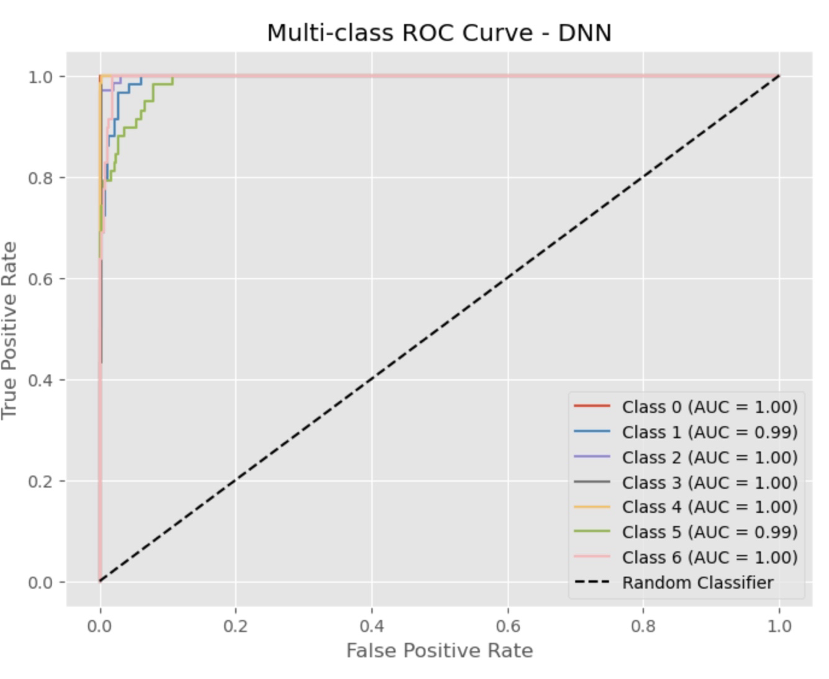
Model Evaluation
Better Performance:
SV
MLP
Gradient Boosting

Slide 11
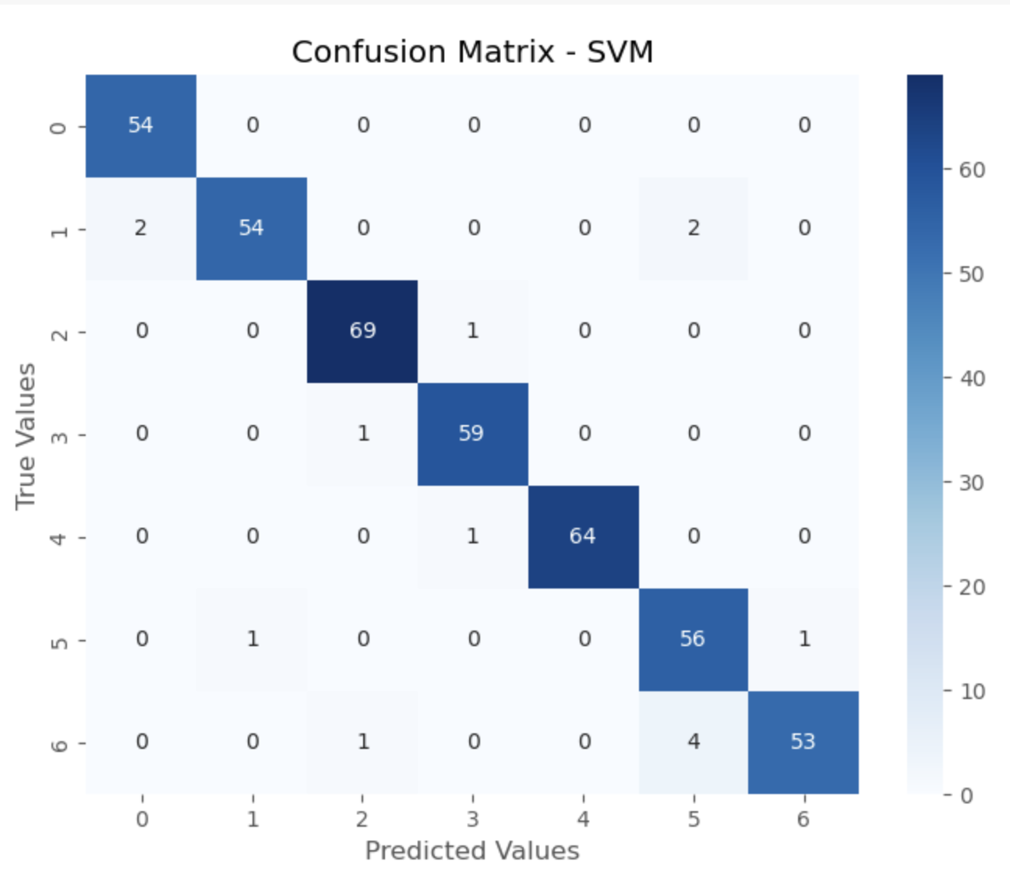
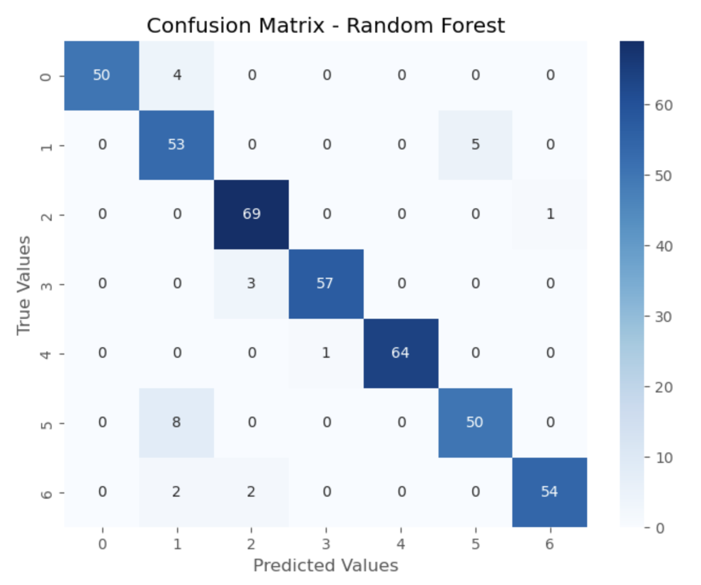
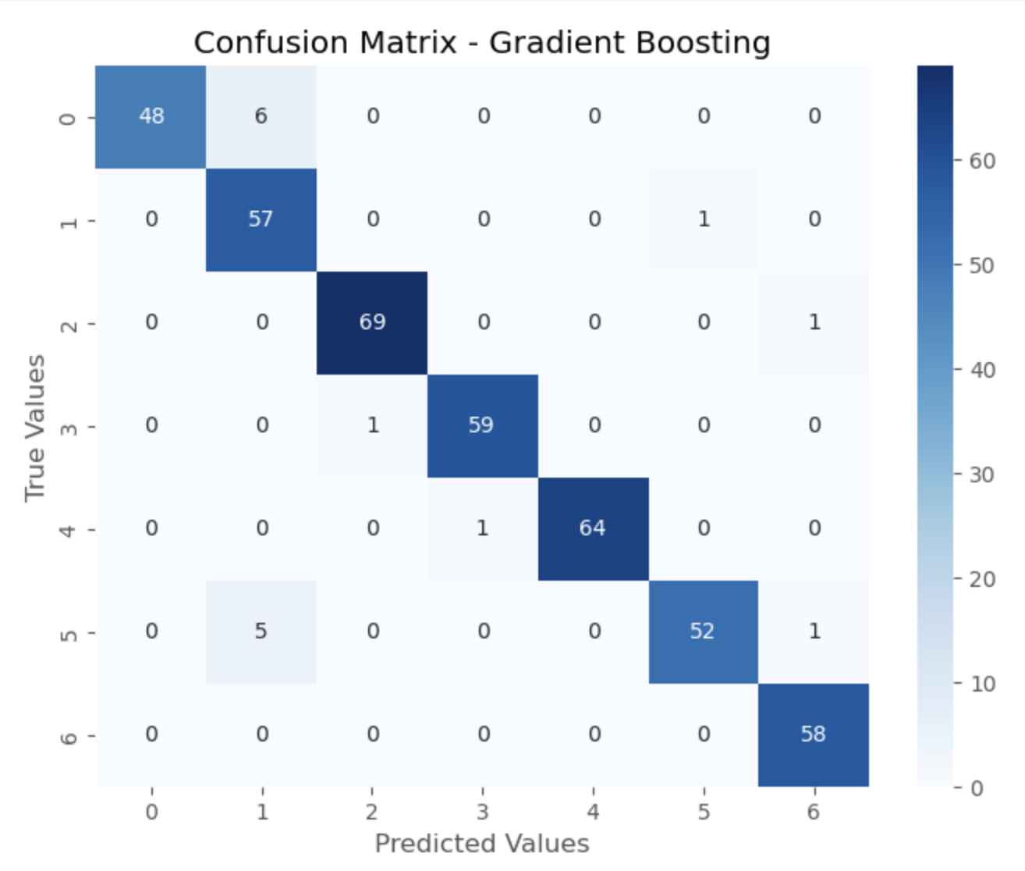
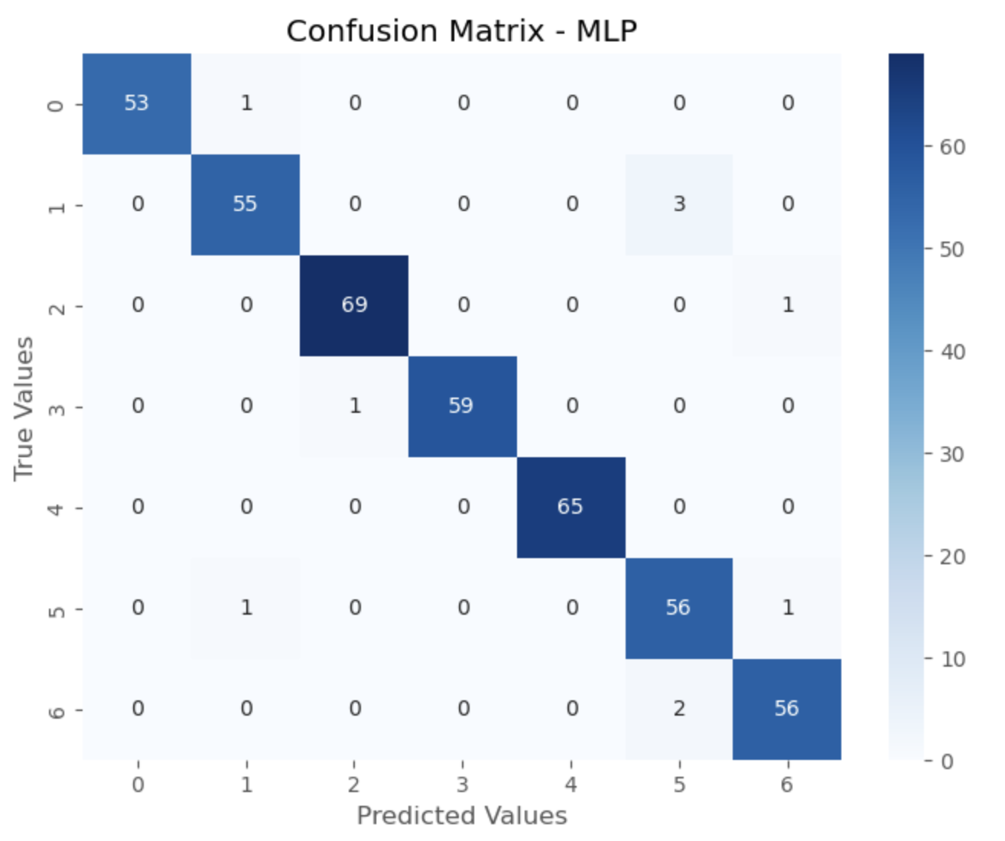
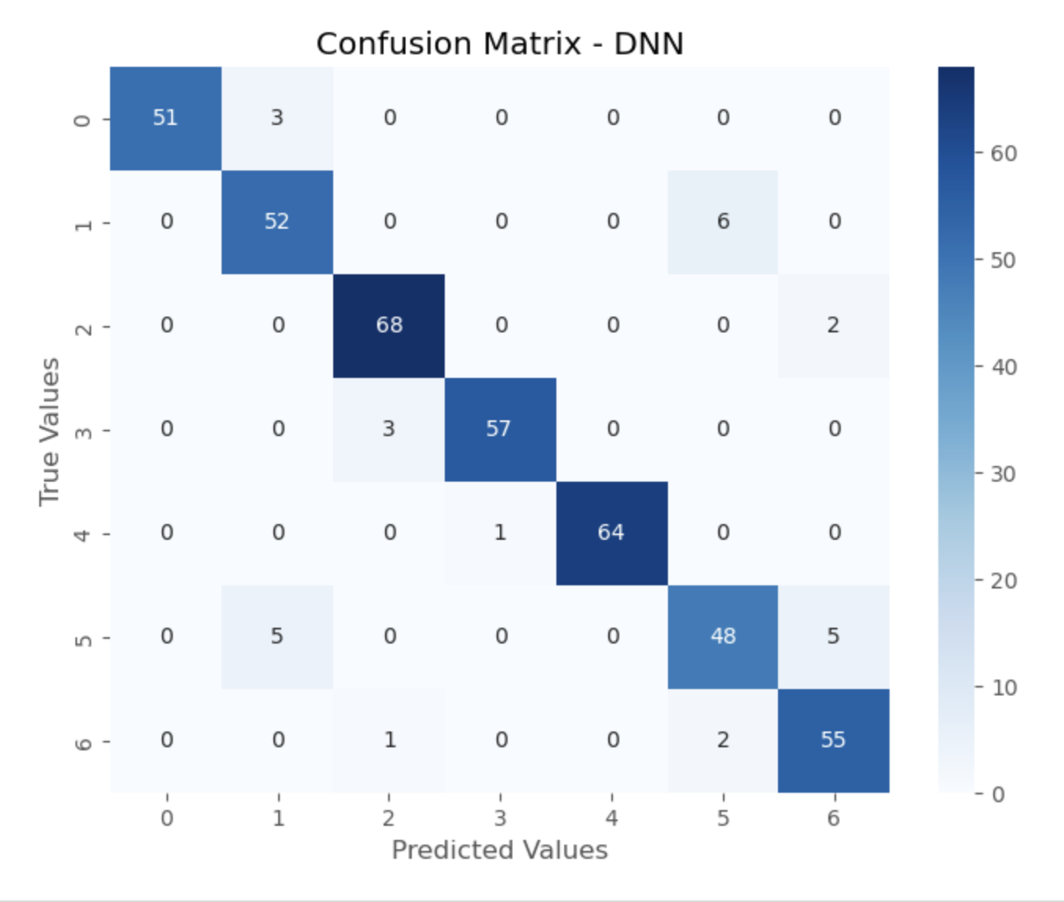
Model Evaluation
Focus on
Class 1 and Class 5

Slide 12
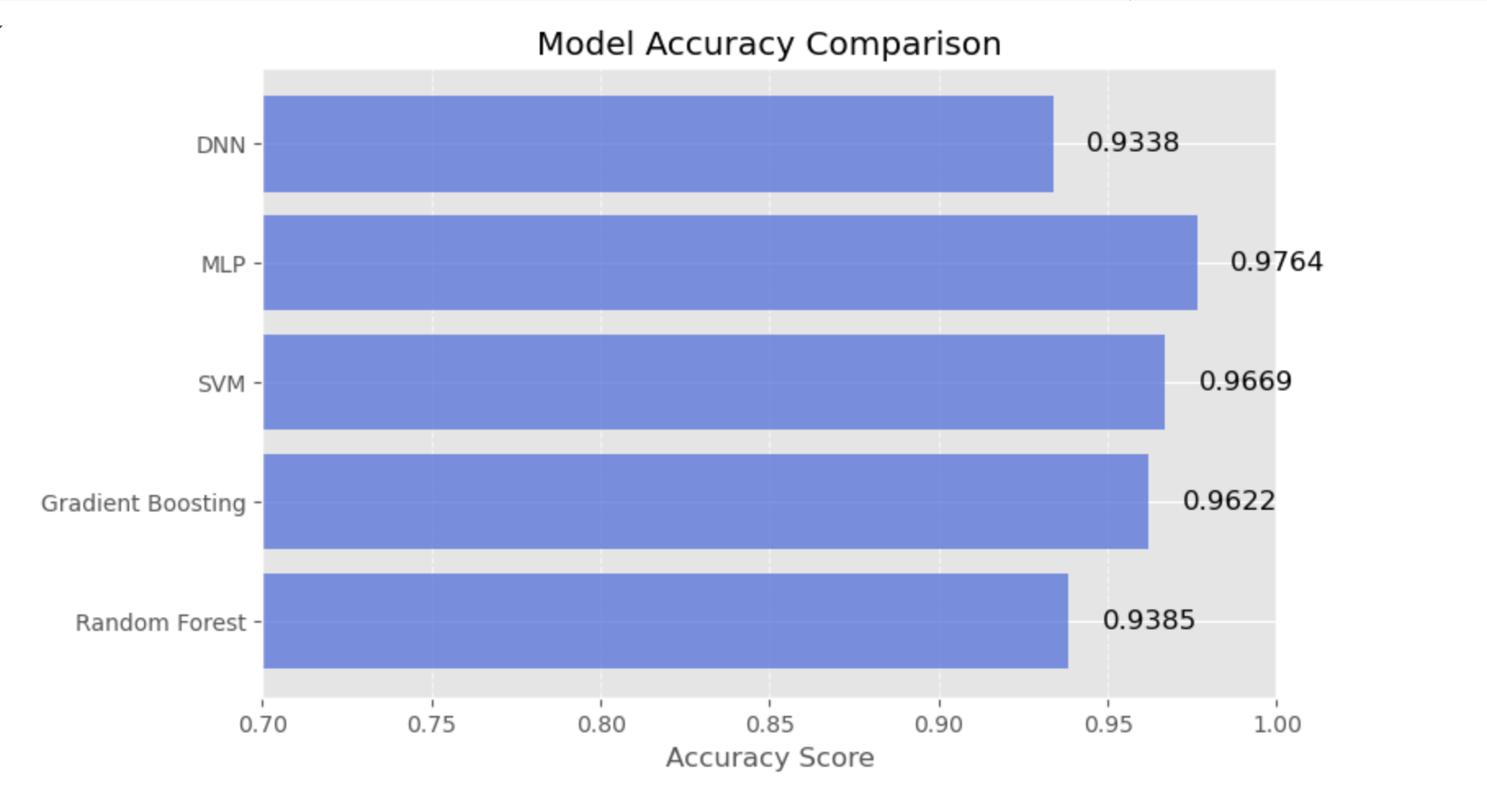
Model Evaluation
If we are interested in model transparency and interpretability, Random Forest and Gradient Boosting are good choices because they provide high accuracy and allow us to analyze feature importance to understand which factors influence classification results the most.
If we aim for the highest classification accuracy, SVM and MLP are preferable, as they achieved the best accuracy in our current dataset and provided the most precise classifications.
However, since our dataset is relatively small, DNN may overfit and not perform as well as other models. DNN tends to excel when dealing with larger datasets, as it can learn complex patterns more effectively.

Slide 13
Model Deployment and Automation
Data Ingestion and Preprocessing
Automated Data Collection
Data Cleaning & Feature Engineering
Model Training & Optimization
Incremental Training
Hyperparameter Tuning
Cross-validation
Model Evaluation
Accuracy;F1 Score;ROC-AUC
Model Deployment
On-Premises
Model Monitoring & Maintenance
Performance Monitoring

Slide 14
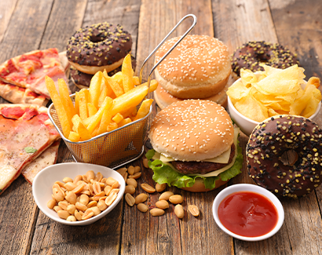
Findings
Obesity is Rising Globally
Urbanization & processed foods drive increases, especially in developing countries.
Top Predictors of Obesity
Key factors: Diet, family history, weight, height, and physical activity.
Less impact: Screen time & hydration levels.
Model Performance
MLP performed best, SVM & Gradient Boosting were strong alternatives.
DNN underperformed due to limited dataset size.
Accuracy & Generalizability
High accuracy due to structured data & balanced classes.
Risk of overfitting—models may not generalize to real-world healthcare settings.
https://images.app.goo.gl/8VVx4TzLiEiCwpvs5

Slide 15

Conclusions
Obesity is a Complex, Multifaceted Issue
Influenced by genetics, lifestyle, environment, and healthcare access.
Machine learning enables early detection and data-driven interventions.
Best Performing Models
MLP had the highest accuracy & generalizability.
SVM & Gradient Boosting were strong alternatives.
DNN underperformed, showing simpler models can be just as effective.
Beyond Prediction: Real-World Impact
Data alone won’t solve the obesity crisis—action is needed.
Governments must prioritize prevention, food access, and physical activity.
Combining machine learning, policy, and behavioral change is key to reducing obesity rates and improving public health.
https://images.app.goo.gl/fKmDLze459XjJonA7

Slide 16
Limitations
Dataset & Generalizability
Focused mainly on diet & physical activity, missing socioeconomic & genetic factors.
Limited diversity—obesity trends vary by region, age, and income levels.
Feature & Model Limitations
Advanced feature engineering not fully explored (e.g., interaction terms).
Grid search tuning was limited—more efficient methods like Bayesian Optimization could improve results.
Computational challenges—Deep learning models (DNN, MLP) require more resources, limiting real-world deployment.

Slide 17
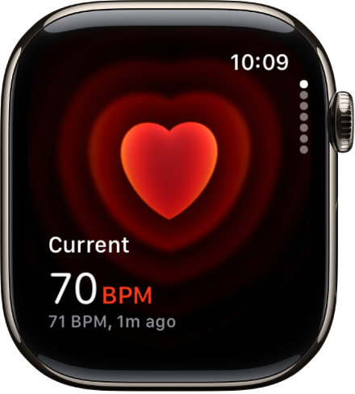
Recommendations
Enhancing the Model
Expand dataset to include socioeconomic & behavioral factors.
Use advanced tuning & ensemble methods for better accuracy.
Real-World Applications
Leverage AI-powered health apps & wearables for personalized insights.
Strengthen public health policies (sugar tax, food labeling, school nutrition).
Addressing Global Disparities
Improve healthcare access & obesity prevention in developing countries.
Regulate food industry marketing & processed food policies.

Slide 18
Data + Policy + Action =
A Healthier Future!

Slide 19

Team Contributions
Lead Developer, wrote all code and conducted feature engineering & EDA for both the project and report.
Designed and developed the PowerPoint presentation and contributed to model training & evaluation in the report.
Zixuan Zhang
Yahui Qian
Responsible for paper writing, structuring findings, and drawing conclusions.
Assisted with research, literature review, and refining key insights.
Chenyi Zhao
Jinghan Feng

Slide 20


Reference
Aiosa, G. V., M. Palesi, and F. Sapuppo. "EXplainable AI for Decision Support to Obesity Comorbidities Diagnosis." IEEE Access 11 (2023): 107767–107782. https://doi.org/10.1109/ACCESS.2023.3320057.
Bogaardt, Laurens, Anoukh Van Giessen, H Susan J Picavet, and Hendriek C Boshuizen. “A Model of Individual BMI Trajectories.” Mathematical Medicine and Biology 41, no. 1 (2024): 1–18. https://doi.org/10.1093/imammb/dqad009.
Cervantes, Rodolfo Cañas, and Ubaldo Martinez Palacio. “Estimation of Obesity Levels Based on Computational Intelligence.” Informatics in Medicine Unlocked 21 (2020): 100472-. https://doi.org/10.1016/j.imu.2020.100472.
Chawla, N. V, K. W Bowyer, L. O Hall, and W. P Kegelmeyer. “SMOTE: Synthetic Minority Over-Sampling Technique.” The Journal of Artificial Intelligence Research 16 (2002): 321–57. https://doi.org/10.1613/jair.953.
DeGregory, K W, P Kuiper, T DeSilvio, J D Pleuss, R Miller, J W Roginski, C B Fisher, et al. “A Review of Machine Learning in Obesity.” Obesity Reviews. 19, no. 5 (2018): 668–85. https://doi.org/10.1111/obr.12667.
Fabio Mendoza Palechor and Alexis de la Hoz Manotas. "Dataset for Estimation of Obesity Levels Based on Eating Habits and Physical Condition in Individuals from Colombia, Peru, and Mexico." Data in Brief 25 (2019): 104344. https://doi.org/10.1016/j.dib.2019.104344.
Ferreira, Sandra Roberta G, Yazmín Macotela, Licio A Velloso, and Marcelo A Mori. “Determinants of Obesity in Latin America.” Nature Metabolism 6, no. 3 (2024): 409–32. https://doi.org/10.1038/s42255-024-00977-1.
Ponte de Lucena, Paulo Henrique, Lidio Mauro Lima de Campos, and Jonathan Cris Pinheiro Garcia. “Predictive Performance of Machine Learning Algorithms Regarding Obesity Levels Based on Physical Activity and Nutritional Habits: A Comprehensive Analysis.” Revista IEEE América Latina 22, no. 9 (2024): 714–22. https://doi.org/10.1109/TLA.2024.10669246.
Notes:
Paula

Slide 21
Reference
Rappange, David R., Werner B. F. Brouwer, Rudolf T. Hoogenveen, and Pieter Van Baal H.M. 2009. "Healthcare Costs and Obesity Prevention: Drug Costs and Other Sector-Specific Consequences." PharmacoEconomics 27 (12) (12): 1031-1044. doi:https://doi.org/10.2165/11319900-000000000-00000. http://turing.library.northwestern.edu/login?url=https://www.proquest.com/scholarly-journals/healthcare-costs-obesity-prevention/docview/222361591/se-2.
Safaei, Mahmood, Elankovan A. Sundararajan, Maha Driss, Wadii Boulila, and Azrulhizam Shapi'i. 2021. "A Systematic Literature Review on Obesity: Understanding the Causes and Consequences of Obesity and Reviewing Various Machine Learning Approaches Used to Predict Obesity." Computers in Biology and Medicine 134 (September): 104344. https://doi.org/10.1016/j.compbiomed.2021.104344.
Sarma, Shohinee, Sanjeev Sockalingam, and Satya Dash. “Obesity as a Multisystem Disease: Trends in Obesity Rates and Obesity‐related Complications.” Diabetes, Obesity & Metabolism. 23, no. S1 (2021): 3–16. https://doi.org/10.1111/dom.14290.
Turchin, Alexander, Fritha J. Morrison, Maria Shubina, Ilya Lipkovich, Shraddha Shinde, Nadia N. Ahmad, and Hong Kan. "EXIST: EXamining rIsk of excesS adiposiTy—Machine Learning to Predict Obesity‐Related Complications." Obesity Science & Practice (2024). https://doi.org/10.1002/osp4.707.
Yamada, Goro, Carlos Castillo-Salgado, Jessica C Jones-Smith, and Lawrence H Moulton. “Differences in Magnitude and Rate of Change in Adult Obesity Distribution by Age and Sex in Mexico, Colombia and Peru, 2005–2010.” Public Health Nutrition 22, no. 4 (2019): 757–63. https://doi.org/10.1017/S1368980018002343.
Notes:
Paula

Slide 22
Thank you!
Questions?

